Slide 1
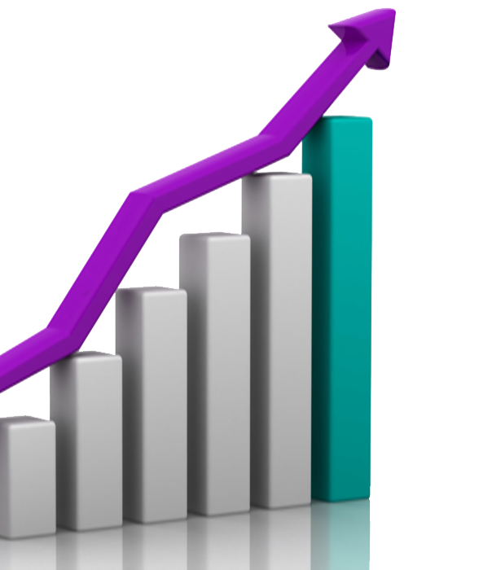
Telangana Growth Analysis
By Abhay Pratap Singh
August 29, 2023
Notes:
Line spacing + Page numbers

Slide 2
Objective
• Explore Stamp Registration, Transportation and Ts-ipass Datasets. Understand their attributes, categories and time period.
• Analyze trends and patterns within each department.
• Identify growth opportunities and areas needing attention.
• Find correlation among these departments and report the overall growth of the state through insights and relevant visuals such as shape maps.

Slide 3


Document And Stamp Registration Analysis
01

Slide 4
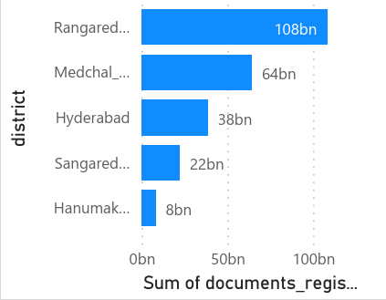
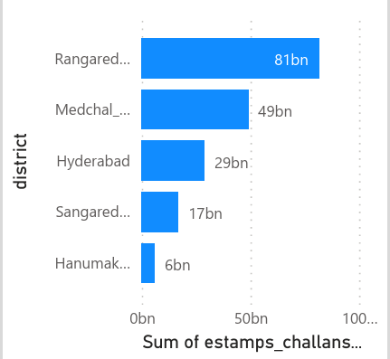
Registration Variation Across Districts
Top 5 districts with highest revenue with Document registration.
Top 5 districts with highest revenue with E-stamps challans

Slide 5
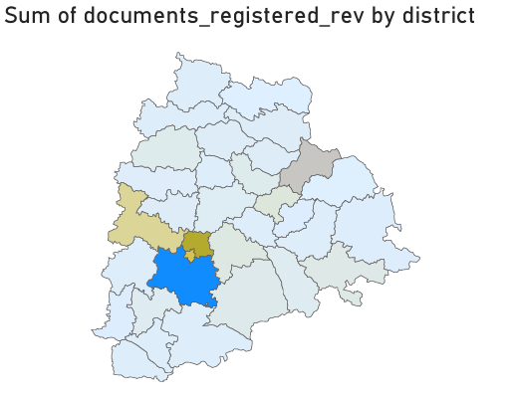
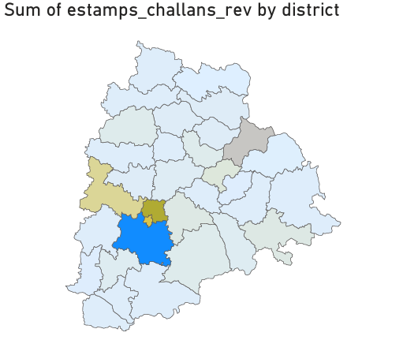
Revenue Variation Across Districts
01
Document registration and E-stamp challans using maps

Slide 6
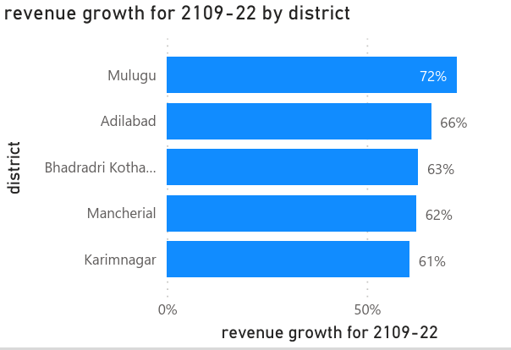
District with highest Document Registration revenue growth between FY2019-2022
01

Slide 7
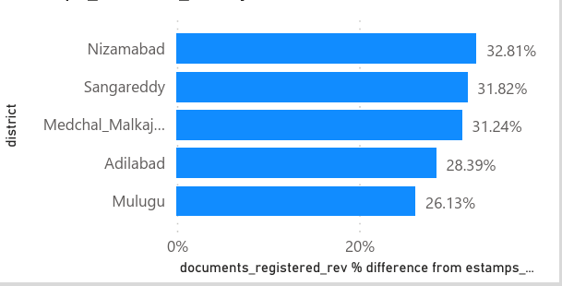
Revenue contribution :
01
Top 5 districts where E-stamps challan revenue contributes more to revenue than the revenue generated by document registration (down to up)

Slide 8
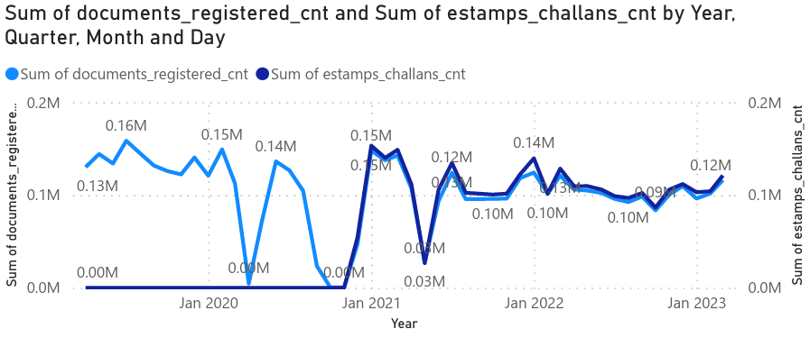
Pattern Analysis Between Revenue Generated
01

Slide 9
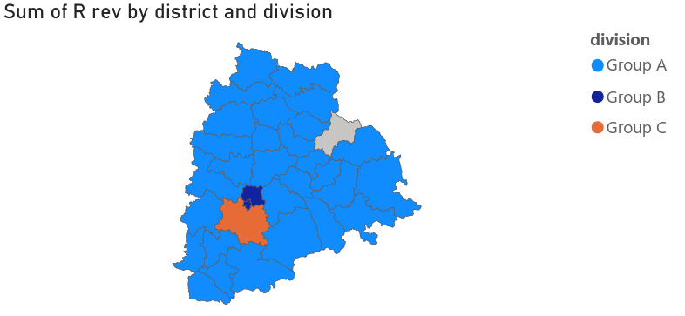
Categorization Of Districts
01
Here districts are categorized into segment based on the revenue generated by the stamp registration.
Group A- 43538381-9918756399
Group B:9918756399-19793974417
Group C-19793974417-onwards
Grey -0

Slide 10
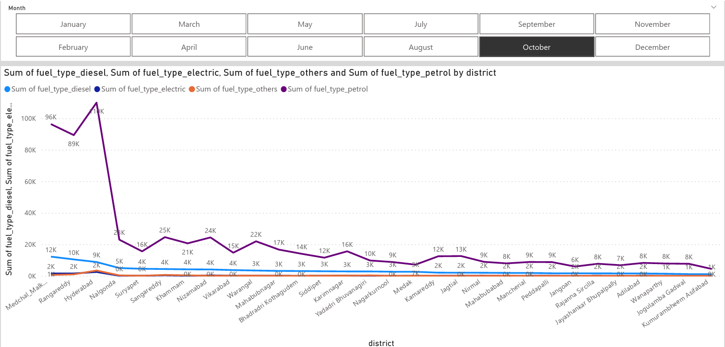
Correlation Between Vehicles Sales And Month Or Seasons
02
This correlation is established by considering the sales of Fuel-type category.
As we can see from the line chart that the month of April and May has less sales than the regular sales in different districts and the month of October has significantly more sales than the various districts
October marks the end of the third quarter for businesses Companies, including car dealerships, which offer special deals or discounts to meet quarterly or yearly sales targets. This can encourage consumers to make purchases during this period.

Slide 11
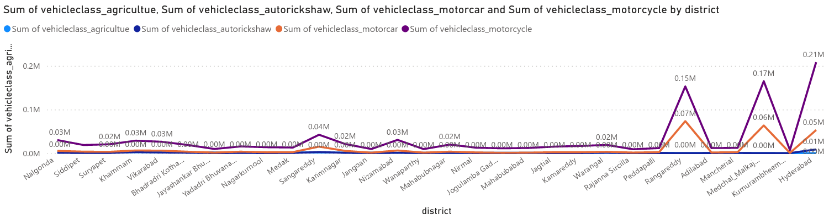
Distribution Of Vehicle By Vehicle Class
02
We can see that state like Rangareddy , Medchal Malkajgiri and Hyderabad had preference to Motor-Cycle class vehicle over other according to FY2022 Data.

Slide 12
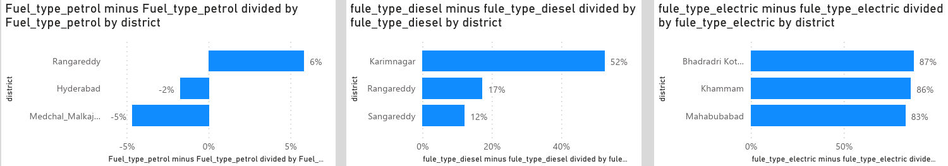
Sales Growth overview for FY2021 to FY 2022
02
These are top 3 districts with highest sales growth during the FY 2022 compared to FY 2021 based on Fuel-Type

Slide 13
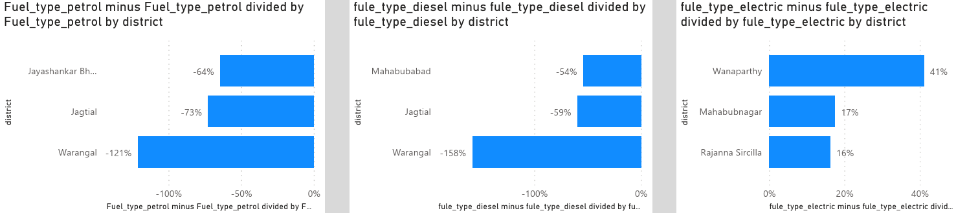
Sales Growth overview for FY2021 to FY 2022
02
These are bottom 3 districts with lowest sales growth during the FY 2022 compared to FY 2021 based on Fuel-Type

Slide 14
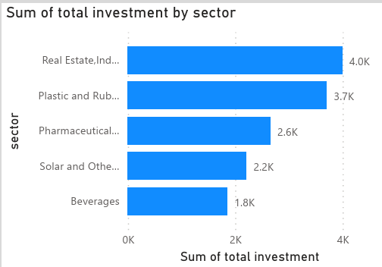
Top 5 Sectors in FY 2022
These are top 5 sectors that have witnessed the most significant investment in FY 2022

Slide 15
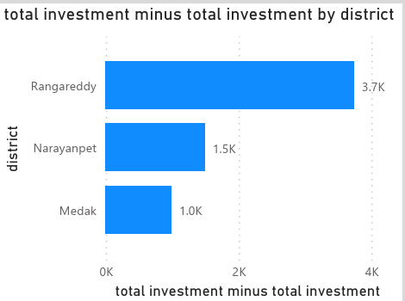
Top 3 districts with significant sector investment
Industrial Corridors: Ranga Reddy district falls within the Chennai-Bengaluru Industrial Corridor and the Hyderabad-Warangal Industrial Corridor.
Information Technology Hub: Hyderabad, the capital of Telangana and part of Rangareddy district, has gained prominence as a major IT and software hub. The presence of numerous IT parks, technology companies, and research institutions has drawn both domestic and international investment, contributing to the growth of the district.
These are some factors which led to substantial sector investment in these particular districts.

Slide 16
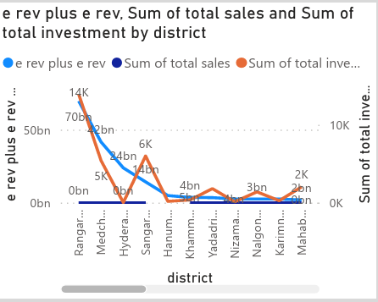
Relation Between District Investment ,vehicles Sales and Stamp Revenue

Slide 17
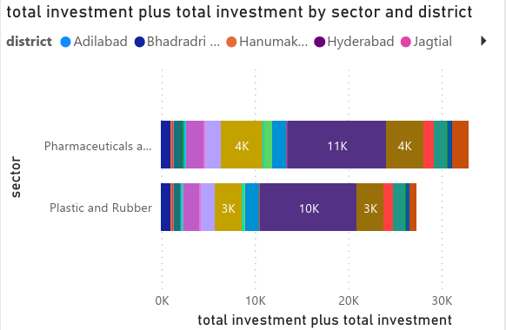
Sector showing multiple investment in every districts
Sectors like Pharmaceuticals and chemicals, Plastics and Rubbers have shown substantially high investment in multiple districts

Slide 18
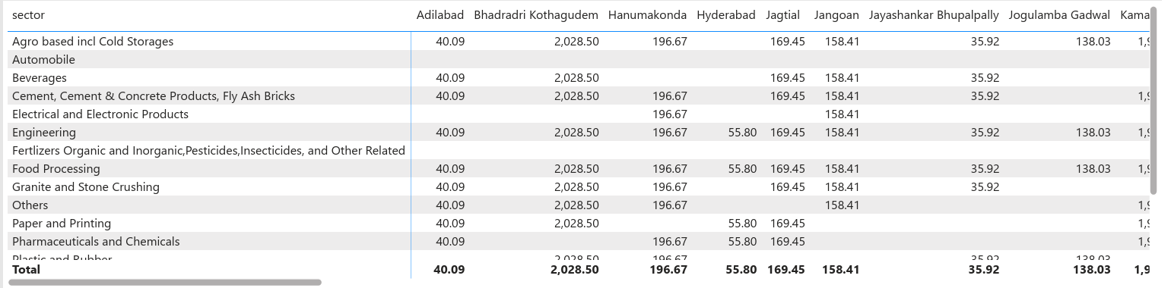
Seasonal trend in Investment

Slide 19
What are the top 5 districts to buy commercial properties in Telangana? Justify your answer.
04
Here are five districts in Telangana that have shown potential for buying commercial properties, along with justifications for each:
Hyderabad: The capital city of Telangana, Hyderabad, is the state's prime commercial hub. It has witnessed substantial growth in IT and software sectors, pharmaceuticals, manufacturing, and various service industries. With its robust infrastructure, skilled workforce, and diverse economy, Hyderabad remains a top choice for commercial property investment.
Rangareddy: Rangareddy district, particularly areas around Hyderabad, has been experiencing significant commercial development. Its proximity to the city, well-established IT parks, and industrial corridors make it an attractive location for businesses looking for well-connected spaces.
Medchal-Malkajgiri: This district is an extension of the Hyderabad metropolitan area and is witnessing rapid urbanization. Its strategic location, along with residential and commercial growth, has led to increased interest from investors and developers.
a

Slide 20
04
4.Warangal Urban: Warangal has been developing as an industrial and educational hub. Its potential for growth in sectors like textiles, engineering, and pharmaceuticals makes it an emerging destination for commercial investments.
5.Sangareddy: This district has gained attention due to its connectivity to both Hyderabad and other important cities like Mumbai and Bengaluru through the National Highway. It has seen growth in sectors like manufacturing, agribusiness, and warehousing.

Slide 21
Insights
05
As implementation of E-stamp challans has increased the revenue generated by districts.
As we can see the sales of fuel type petrol vehicle is significantly larger than others.
As fuel type petrol and diesel vehicles are more respective to electric cause increase of pollution and increases the use of petroleum resources.
Sectors like Pharmaceuticals and Plastic and Rubber industry are playing crucial roles in investment to different districts.

Slide 22
Recommendations
05
Increase the sales of Electric vehicles to reduce the usage of petroleum resources.
While urban areas have seen substantial growth, rural development should not be neglected. Improve agricultural productivity, provide rural infrastructure, and support entrepreneurship in rural areas to achieve balanced development.
Encourage investments in sectors beyond IT, such as manufacturing, agribusiness, renewable energy, and healthcare. Offer incentives and create a business-friendly environment for these industries to thrive.

Slide 23


Closing
05
Thanks to CodeBasics and Telangana government for providing data to us for learning purpose.
Abhay Pratap Singh
abhaypratapsingh16072004 @gmail.com

